Slide 1
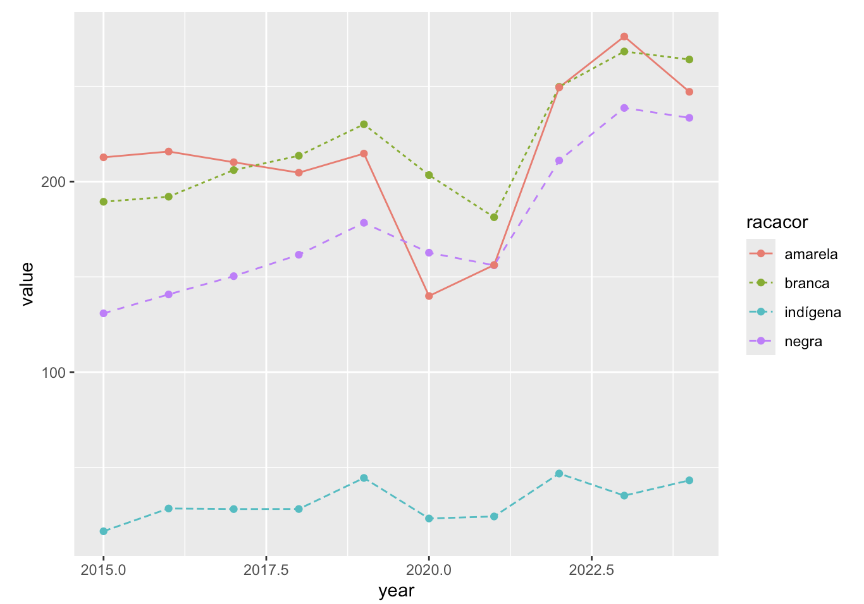
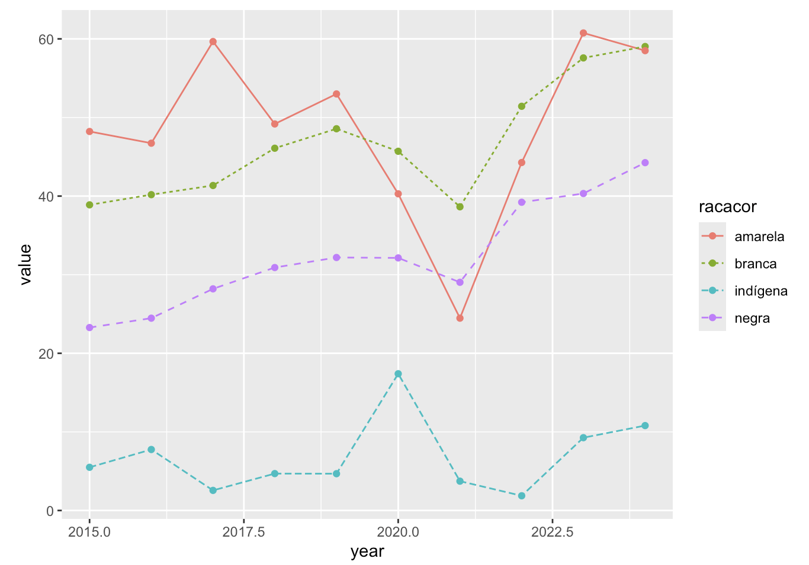
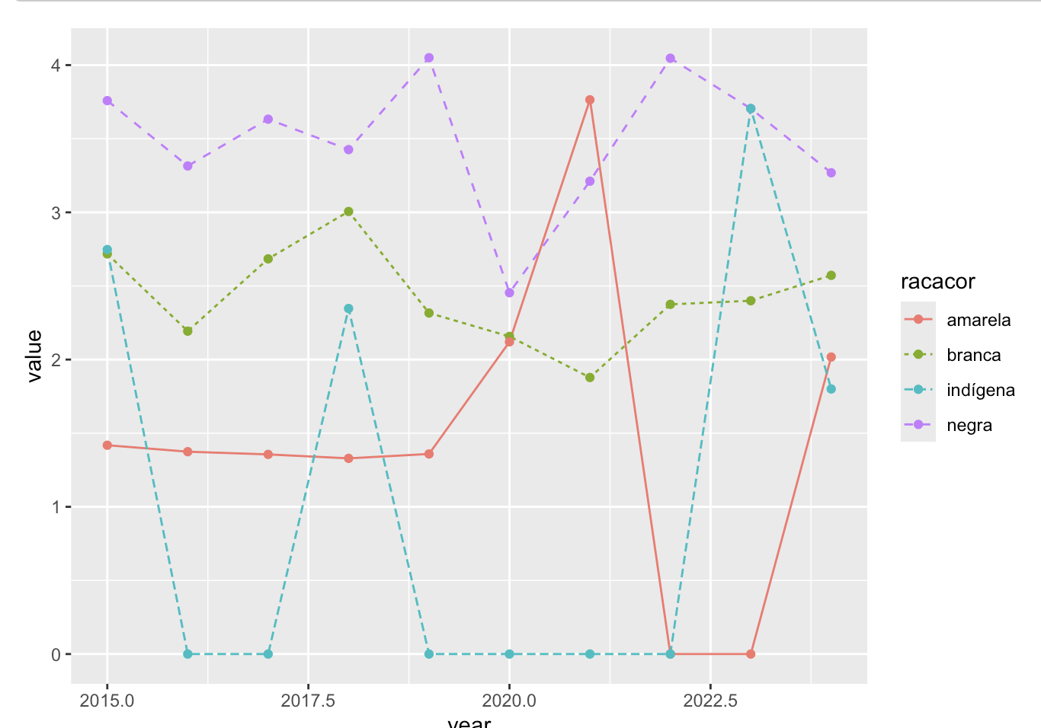
Alzheimer’s Disease
Parkinson’s Disease
Neuroblastoma
Race/color
Race/color
Race/color
Asian
Asian
Asian
Relative Mortality
White
White
Relative Mortality
Relative Mortality
Indigenous
White
Indigenous
Indigenous
Negro (Black)
Negro (Black)
Negro (Black)

Slide 2
Alzheimer’s Disease
Parkinson’s Disease
Neuroblastoma
Race/color
Asian
Relative Mortality
Relative Mortality
Relative Mortality
White
Indigenous
Negro (Black)

Slide 3
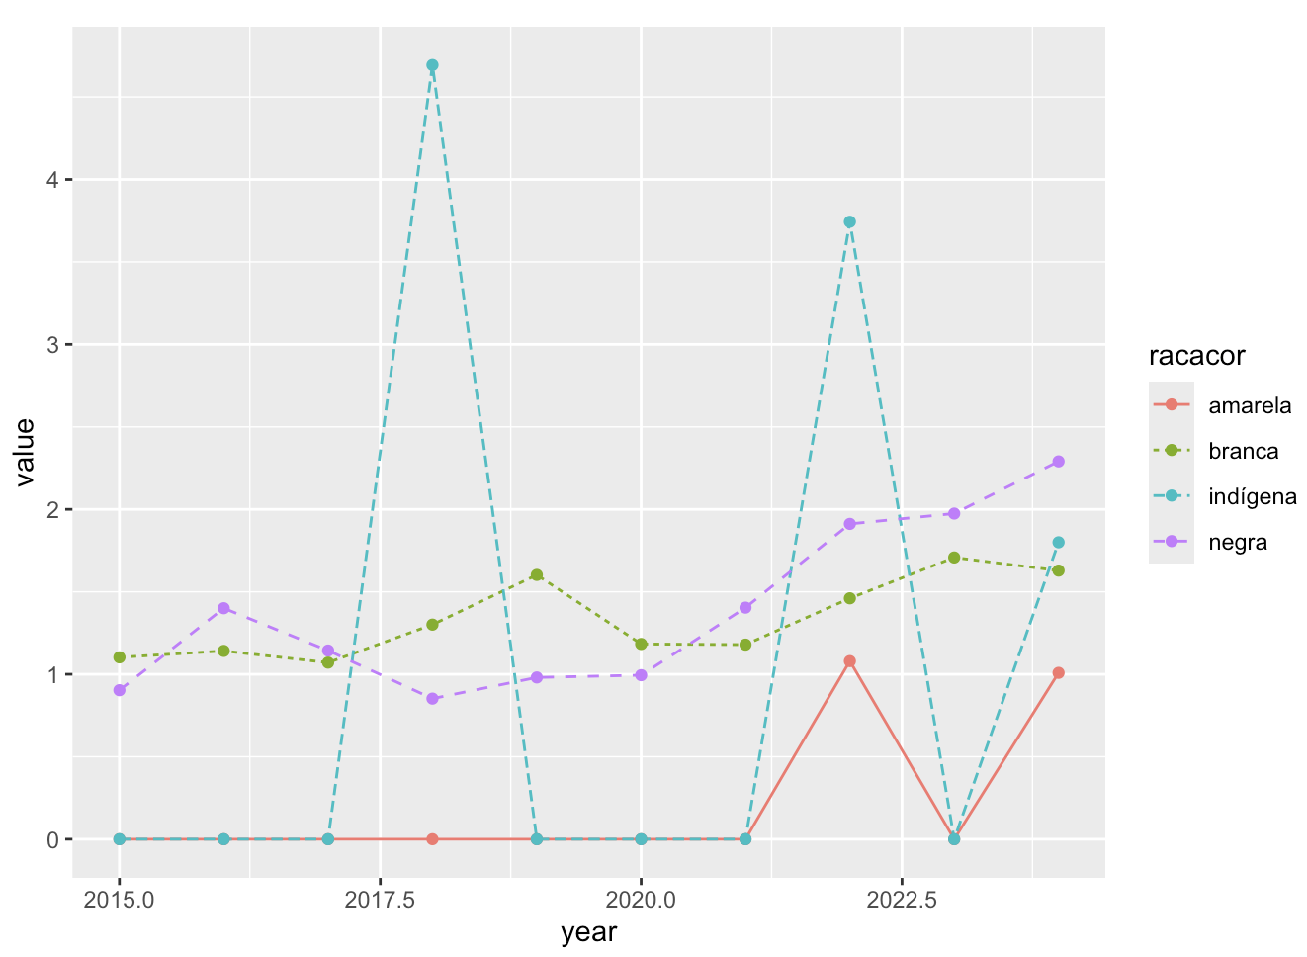
A)
Alzheimer’s Disease
B)
Parkinson’s Disease
Race/color
Relative Mortality
Relative Mortality
Asian
White
Indigenous
Negra (Black)
C)
Huntington’s Disease
D)
Neuroblastoma
Race/color
Relative Mortality
Relative Mortality
Asian
White
Indigenous
Negra (Black)
year
year

